Slide 1

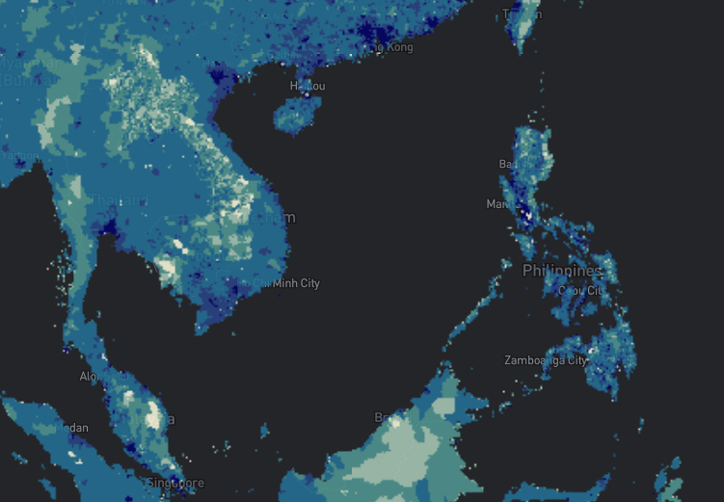
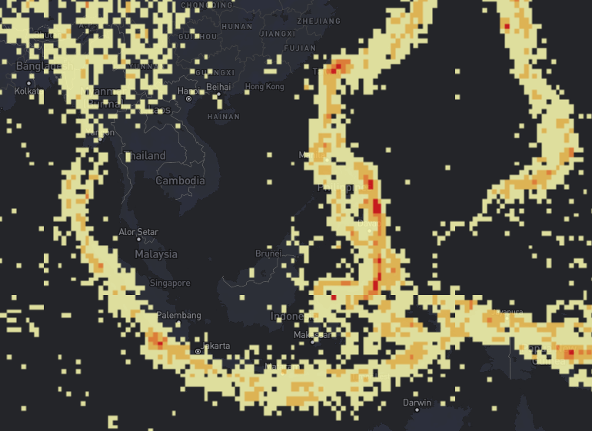
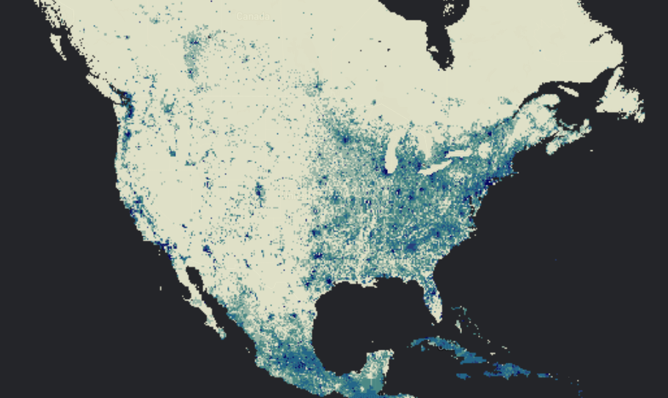
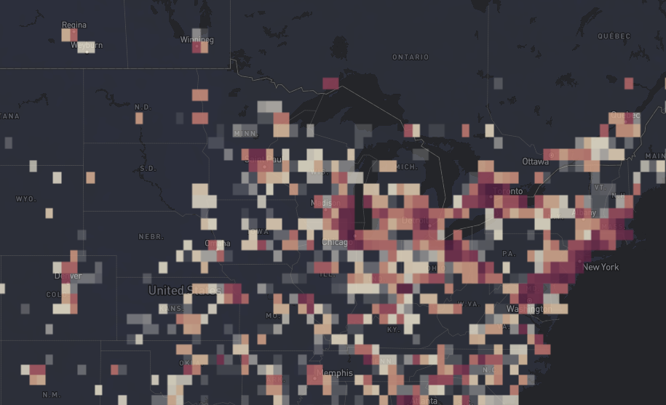
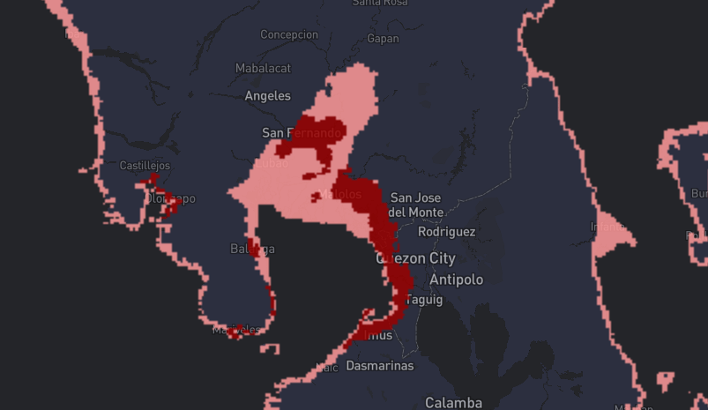
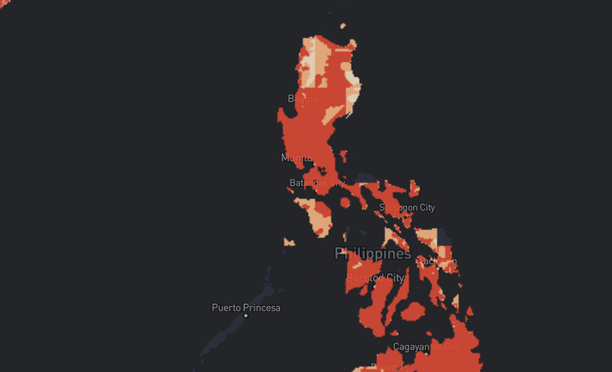
Planet, With People
Global Hazard Exposure and Resilience Trends
By Earth Observation Analysis Tools (Global HEARTBEAT)
Satellite data is a rich source of information on our communities. Detailed satellite mapping has been accomplished through the NASA Socioeconomic Data and Applications Center (SEDAC), but much of this information is unknown to researchers and inaccessible to people without specialized tools and training.
We are a team from Canada and the Philippines and our mission is to develop an interface to present SEDAC data in a way that can be of tremendous value to users.

Slide 2
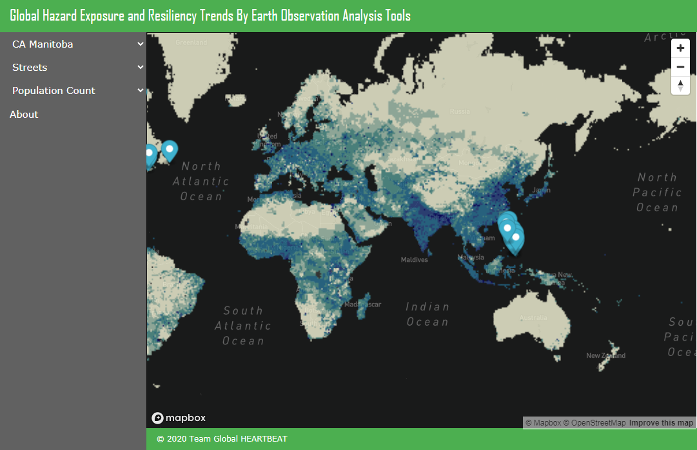
Our Solution
Global Hazard Exposure and Resilience Trends
By Earth Observation Analysis Tools (Global HEARTBEAT)
Global HEARTBEAT is an interactive web-portal aimed at providing geo-located information on natural and human hazards surrounding the communities of the Philippines and Canada. Using the tool, users will be able to overlay various satellite layers against socio-economic data gathered by our researchers.

Slide 3
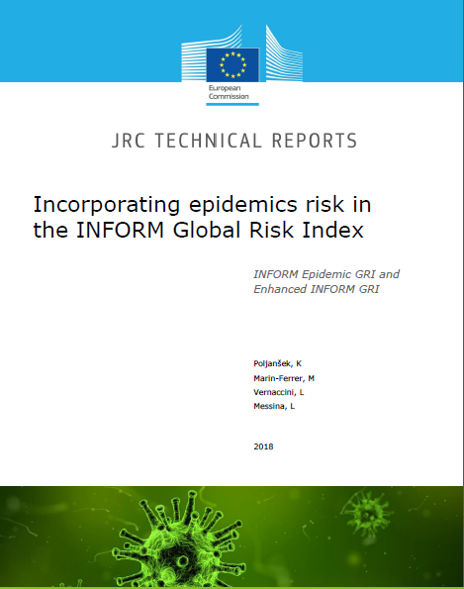
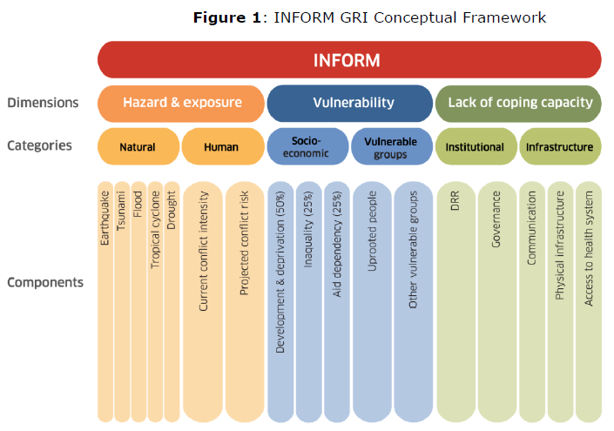
How It Works
Global Hazard Exposure and Resilience Trends
By Earth Observation Analysis Tools (Global HEARTBEAT)
We combine the NASA SEDAC data with relevant socio-economic statistics. Using the INFORM framework of EU JRC, we present a risk-based information portal on Philippines and Canadian communities.
By overlaying socio-economic data with satellite maps, users can be provided with additional ideas on disaster resilience, sustainable community development, and in general is an excellent educational resource on the diversity of our communities.
Prototype: http://ec2-3-23-60-243.us-east-2.compute.amazonaws.com/

Slide 4
Our Resources and Inspirations
Global Hazard Exposure and Resilience Trends
By Earth Observation Analysis Tools (Global HEARTBEAT)
NASA SEDAC https://sedac.ciesin.columbia.edu/mapping/gmis-hbase/explore-view/ | Facebook Disaster Maps https://dataforgood.fb.com/tools/disaster-maps/
EU JRC: INFORM https://drmkc.jrc.ec.europa.eu/inform-index | Digital Mapping Global Explorer https://goexplorer.org/digital-mapping-tool-aids-disaster-management/
Hazard Hunter https://hazardhunter.georisk.gov.ph/ | National Center for Disaster Preparedness https://ncdp.columbia.edu/microsite-page/hurricane-season-2017/hurricane-season-2017-mapping-tools/
Human Capital Project https://ghsl.jrc.ec.europa.eu/atlas2019Overview.php | PHIVOLCS Hazard Maps https://www.phivolcs.dost.gov.ph/index.php/gisweb-hazard-maps
Worldview https://worldview.earthdata.nasa.gov/ | Humanitarian Data Exchange https://data.humdata.org/

Slide 5
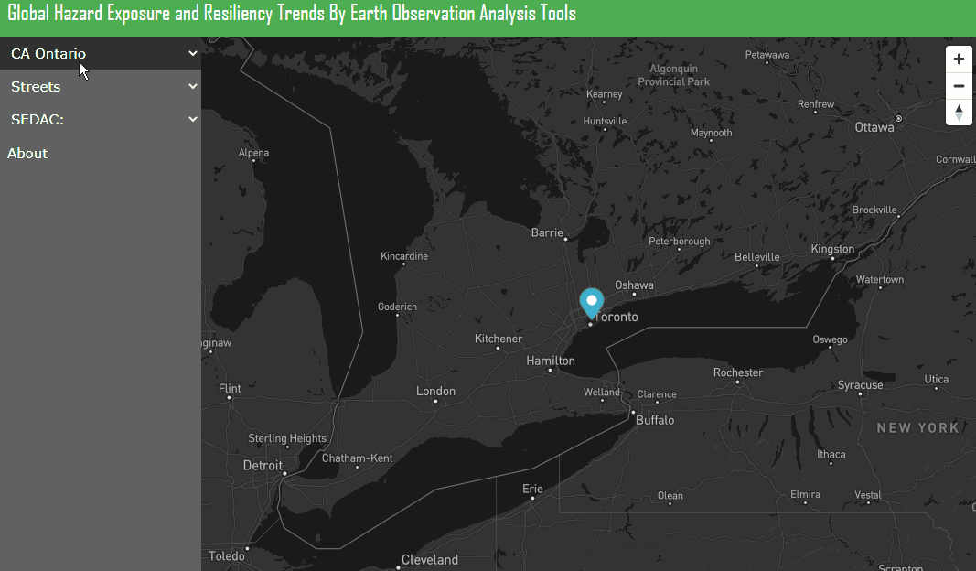
Built With
Global Hazard Exposure and Resilience Trends
By Earth Observation Analysis Tools (Global HEARTBEAT)
SEDAC WMS API
MapBox API
OpenStreetMap
HTML 5 / CSS / JS
AWS

Slide 6
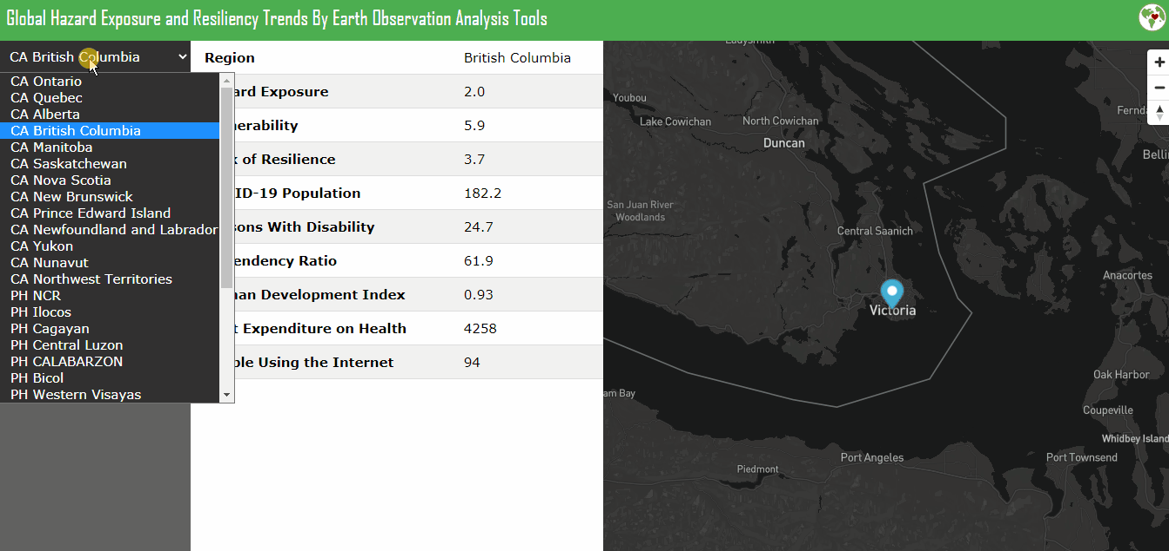
Future Plans: Satellite-driven Risk Assessment
Global Hazard Exposure and Resilience Trends
By Earth Observation Analysis Tools (Global HEARTBEAT)
Our tool can allow interactive exploration of the rich SEDAC data and comparison with local socio-economic indicators.
By integrating with INFORM, risk-based insights and policies can be formed using the tool.

Slide 7







Our Team
Global Hazard Exposure and Resilience Trends
By Earth Observation Analysis Tools (Global HEARTBEAT)
Denise Brennan-Rieder - CAN
Medical Researcher, Protein Chemistry
Emily Jo Vizmonte - PHL
Analytics Consultant
Cricket Soong - PHL
Emerging Technologies Consultant
Rachelle Leah Melendres - PHL
Analytics Consultant
Mark Pascual - PHL
Full Stack Developer | Data Science

